Slide 1
Trace Clustering in Process Mining
M. Song, C.W. Gunther, and W.M.P. van der Aalst
Test Project by Asad Tariq

Slide 2
Background
Existing Process Mining techniques perform well on structured processes, but still have problems discovering and visualizing less structured ones.
Process mining is most interesting in domains requiring flexibility.
Examples for such flexible environments are healthcare, product development, or customer support.

Slide 3
Motivation
Inherent problems of applying process mining to flexible environments.
Process Mining on such flexible environments result in “Spaghetti models”.
One dominant factor contributing to unstructured mining results is “Diversity” of an event log.

Slide 4
Diversity
Single cases differ significantly from one another.
A set of cases are structured very differently, obviously grows with the number of cases being analyzed.

Slide 5
Possible Solution
Reduce the number of cases which are analyzed at once.
Tacit processes will usually not be explicitly known,
i.e., there is no available knowledge on how to partition the set of cases.

Slide 6
Proposed Approach
Trace Clustering Approach.
Divide-and-conquer approach.
Based on set of Profiles.
Activity Profile
Resources Profile
Transition Profile

Slide 7
Trace Clustering
Divide-and-conquer approach.
Trace Profiling.
Compute distances between the cases.
Apply Clustering Algorithms.
Grouping closely related cases into subsets.
Analyze the individual subsets.

Slide 8
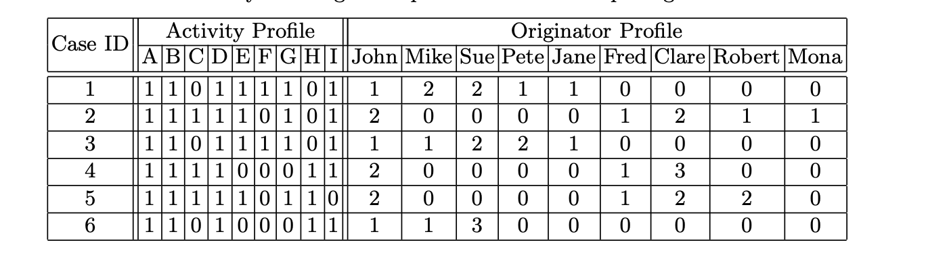
Trace Profiles
Determine similarities between cases for Clustering.
Activity Profile
Resource Profile
Transition Profile
Performance Profile

Slide 9
Distance Measures
Clustering techniques use different Distance Measures.
Euclidean Distance
Hamming Distance
Jaccard Distance

Slide 10
Clustering Methods
Using the trace profile concept, these four clustering techniques have been used to generate homogeneous subsets of event log.
K-means Clustering
Quality Threshold Clustering
Agglomerative Hierarchical Clustering
Self-Organizing Map

Slide 11
Quality Metrics
We used 3 quality metrics to test the approach.
Fitness
Precision
Simplicity

Slide 12
Case Studies
2 Case Studies
1. Road Traffic event log (51 cases)
2. Repair Event log (1104 cases)

Slide 13
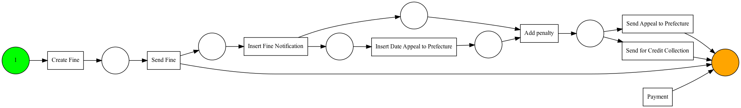
Case 1 – Road Traffic
Activity Profile
Fitness : 79%
Precision : 64%
Simplicity : 80%

Slide 14
K Means Clustering
Euclidean Distance
3 Clusters. ( 23, 19, 9)
Quality improved significantly.

Slide 15
K Means Clustering
Cluster 1 – 23 traces
Fitness : 99%
Precision : 99%
Simplicity : 100%

Slide 16

K Means Clustering
Cluster 2 – 19 traces
Fitness : 86%
Precision : 100%
Simplicity : 100%

Slide 17
K Means Clustering
Cluster 3 – 9 traces
Fitness : 95%
Simplicity : 100%

Slide 18
DB Scan
Hamming Distance - 2 Sub Event Logs
Euclidean Distance – 4 Sub Event Logs
Jaccard Distance – 3 Event Logs

Slide 19
DB Scan - Hamming Distance
Sub Event Log 1
Fitness : 86%
Precision : 100%
Simplicity : 100%
Sub Event Log 2
Fitness : 98%
Precision : 100%
Simplicity : 100%

Slide 20

DB Scan - Euclidean Distance
Sub Event Log 1
Fitness : 100%
Precision : 100%
Simplicity : 100%
Sub Event Log 2
Fitness : 100%
Precision : 100%
Simplicity : 100%

Slide 21
DB Scan - Euclidean Distance
Sub Event Log 3
Fitness : 96%
Precision : 100%
Simplicity : 100%
Sub Event Log 4
Fitness : 100%
Precision : 100%
Simplicity : 100%

Slide 22

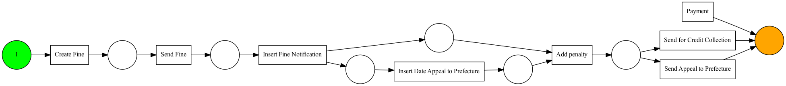
DB Scan - Jaccard Distance
Sub Event Log 1
Fitness : 100%
Precision : 100%
Simplicity : 100%
Sub Event Log 2
Fitness : 84%
Precision : 50%
Simplicity : 89%

Slide 23

DB Scan - Jaccard Distance
Sub Event Log 3
Fitness : 100%
Precision : 100%
Simplicity : 100%

Slide 24
Agglomerative Clustering
Hierarchical Clustering
Euclidean Distance
3 Clusters. ( 19, 23, 9)
Quality improved significantly.

Slide 25
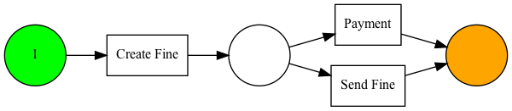
Agglomerative Clustering
Sub Event Log 1
Fitness : 86%
Precision : 99%
Simplicity : 88%
Sub Event Log 2
Fitness : 100%
Precision : 100%
Simplicity : 100%

Slide 26
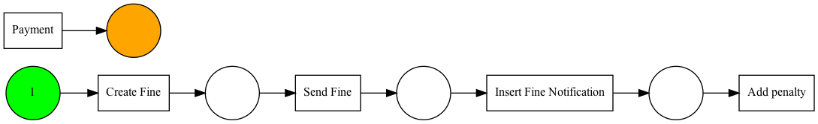
Agglomerative Clustering
Sub Event Log 3
Fitness : 98%
Precision : 57%
Simplicity : 100%

Slide 27
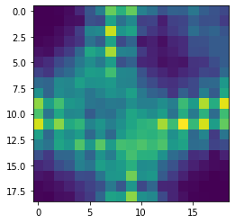
Self Organizing Maps
6 Clusters. (22, 2, 7, 1, 7, 12)
Quality improved significantly.

Slide 28
Self Organizing Maps
Sub Event Log 1
Fitness : 100%
Precision : 100%
Simplicity : 100%
Sub Event Log 2
Fitness : 91%
Precision : 60%
Simplicity : 100%

Slide 29
Self Organizing Maps
Sub Event Log 3
Fitness : 100%
Precision : 100%
Simplicity : 100%
Sub Event Log 4
Fitness : 100%
Precision : 100%
Simplicity : 100%

Slide 30
Self Organizing Maps
Sub Event Log 5
Fitness : 100%
Precision : 100%
Simplicity : 100%
Sub Event Log 6
Fitness : 100%
Precision : 100%
Simplicity : 100%

Slide 31
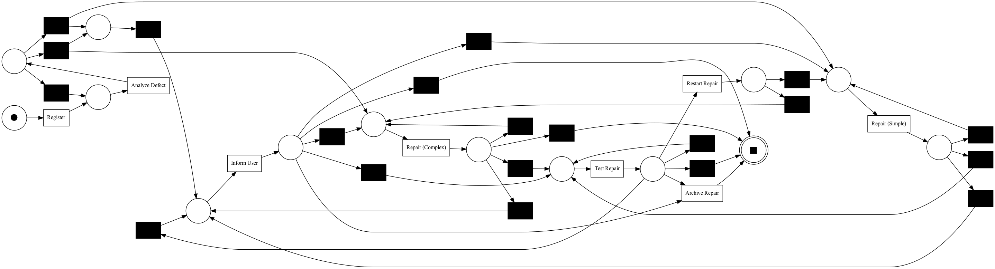
Case 2 – Repair Log – Activity Profile
Activity Profile
1104 traces
8 Activities

Slide 32
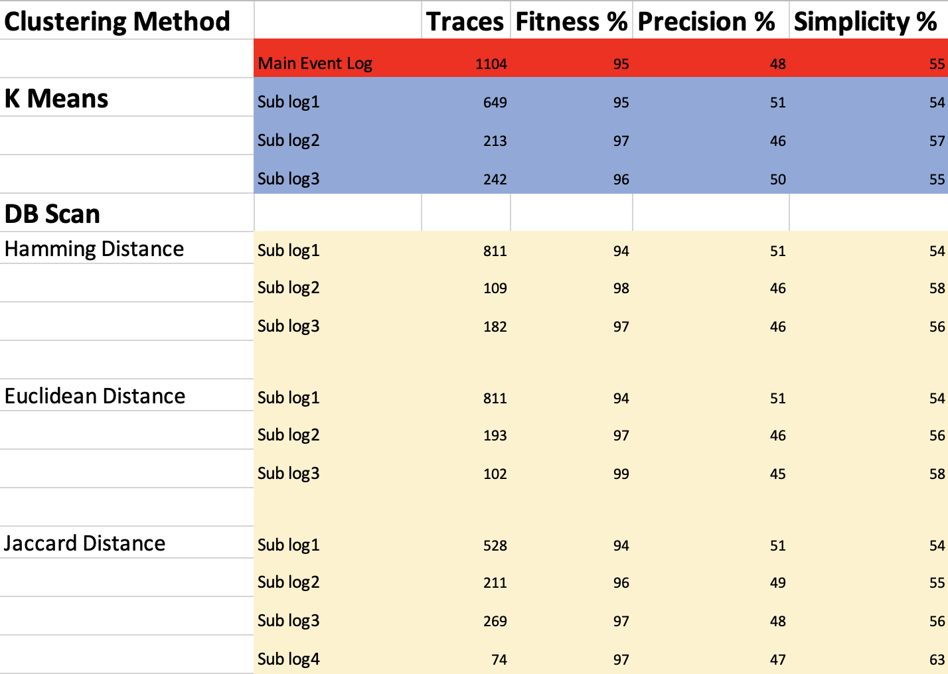
Case 2 – Repair Log - Results

Slide 33
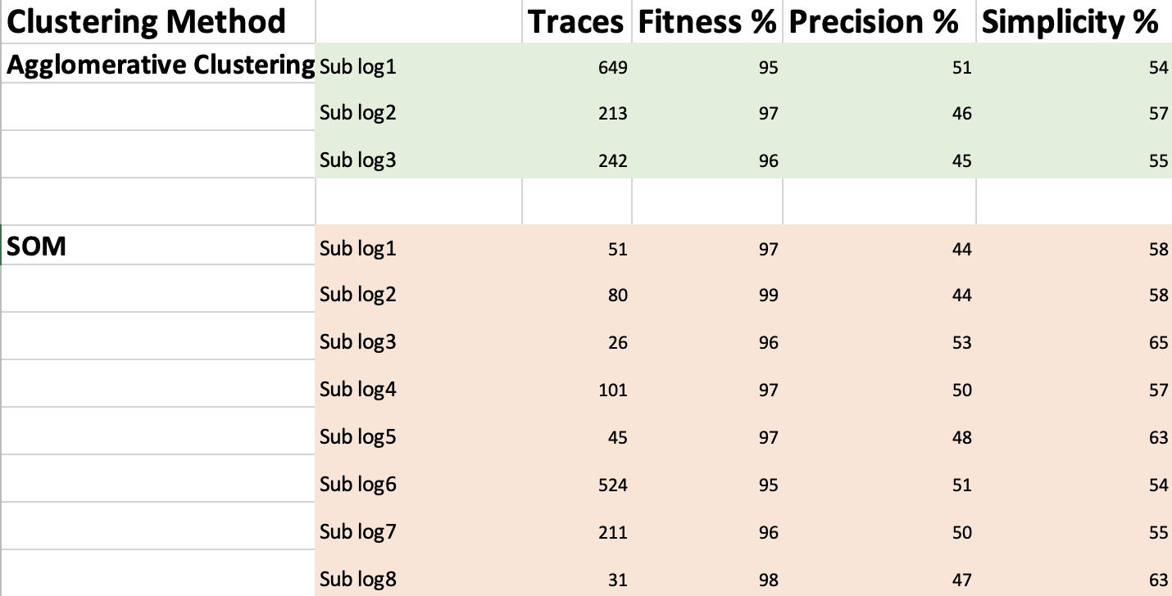
Case 2 – Repair Log - Results

Slide 34
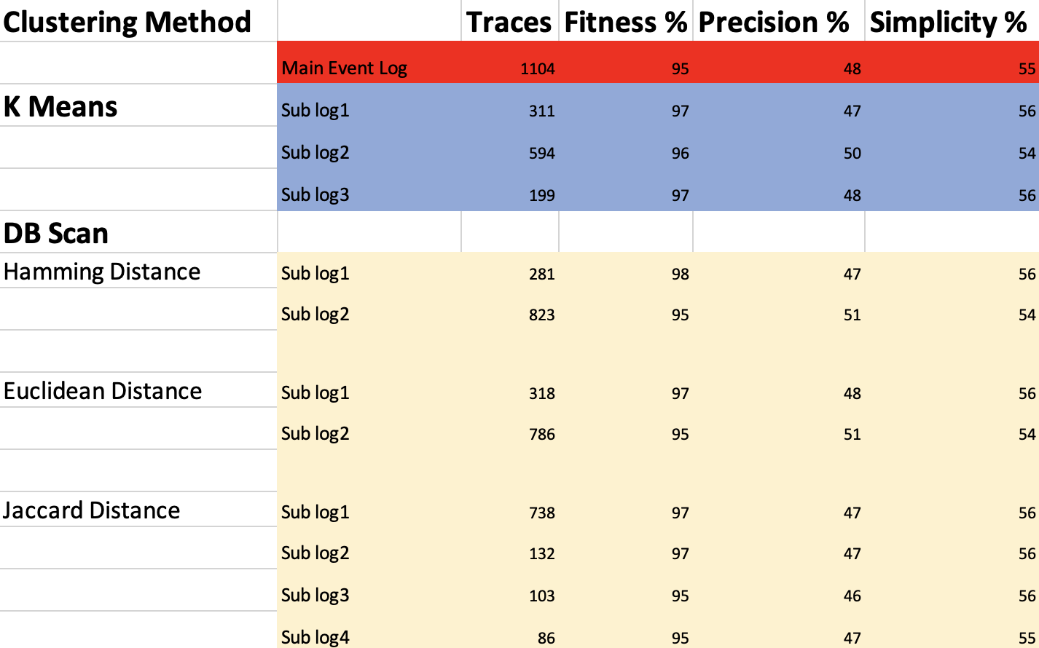
Case 2 – Repair Log – Resource Profiling

Slide 35
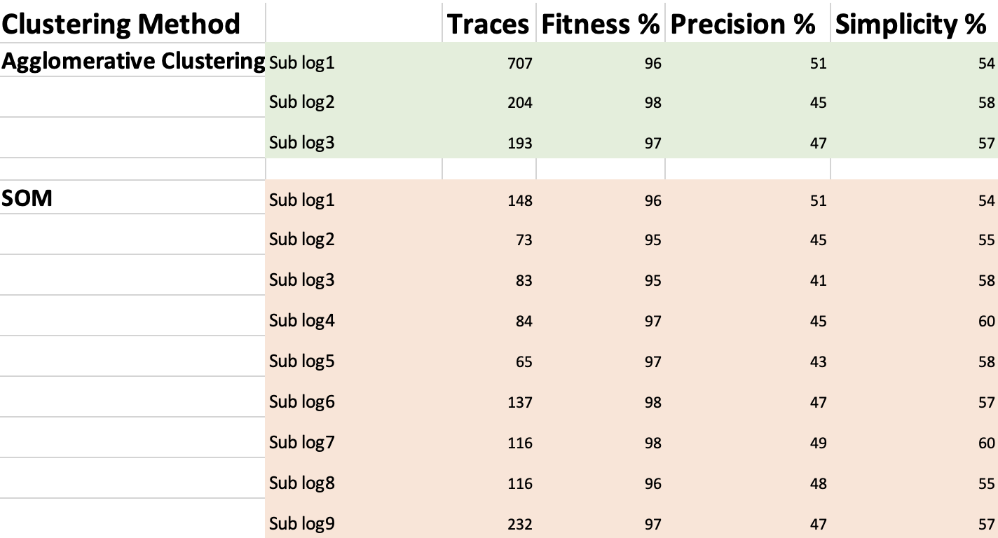
Case 2 – Repair Log – Resource Profiling

Slide 36
Code and Results
The implementation and Results can be found here.

Slide 37
Conclusion
Process mining algorithms tend to generate complex, unstructured process models for Flexible environments, which are hard to understand. One reason for these problems is diversity.
A generic methodology for trace clustering is presented, which can effectively resolve diversity-related problems, by dividing the log into smaller, more homogeneous subsets of traces. We have introduced the concept of trace profiles, which are a suitable means for characterizing and comparing traces. Based on these profiles, any clustering algorithm can be employed for the actual partitioning of the log.

